Slide 1
MedTrust: A Unified Blockchain Framework for Dual-Layer Verification of Prescription Authenticity and Drug Provenance
Abhishek Soni
Arin V Jain
Neelansh Dosi
SVKM’s NMIMS, Indore Campus

Slide 2
Problem Statement
The Core Gap:
Healthcare validates digital medical orders and physical drug packages in isolated silos, with zero cross-verification at the retail pharmacy counter.
Prescription Silo:
Authenticates physician identity at consultation, but has zero visibility into the physical medicine handed to the patient.
Supply Chain Silo:
Tracks batch logistics between manufacturers and distributors, but cannot verify if the customer holds a valid, active prescription.
The Resulting Fraud:
  Prescription Replay & Diversion: Forged or duplicated orders draw genuine drugs (fueling opioid abuse and doctor-shopping).
  Counterfeit Infiltration: Legitimate prescriptions are fulfilled with fake, expired, or CDSCO-recalled batches.
Our Solution:
An Atomic Gateway Contract on Hyperledger Fabric that executes synchronous dual-layer verification before dispensing, while ensuring zero patient PII on-chain.

Slide 3
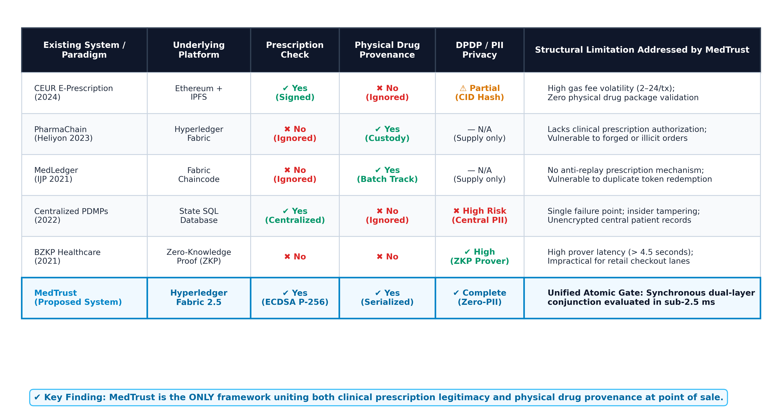
Literature Review & Gap Analysis

Slide 4
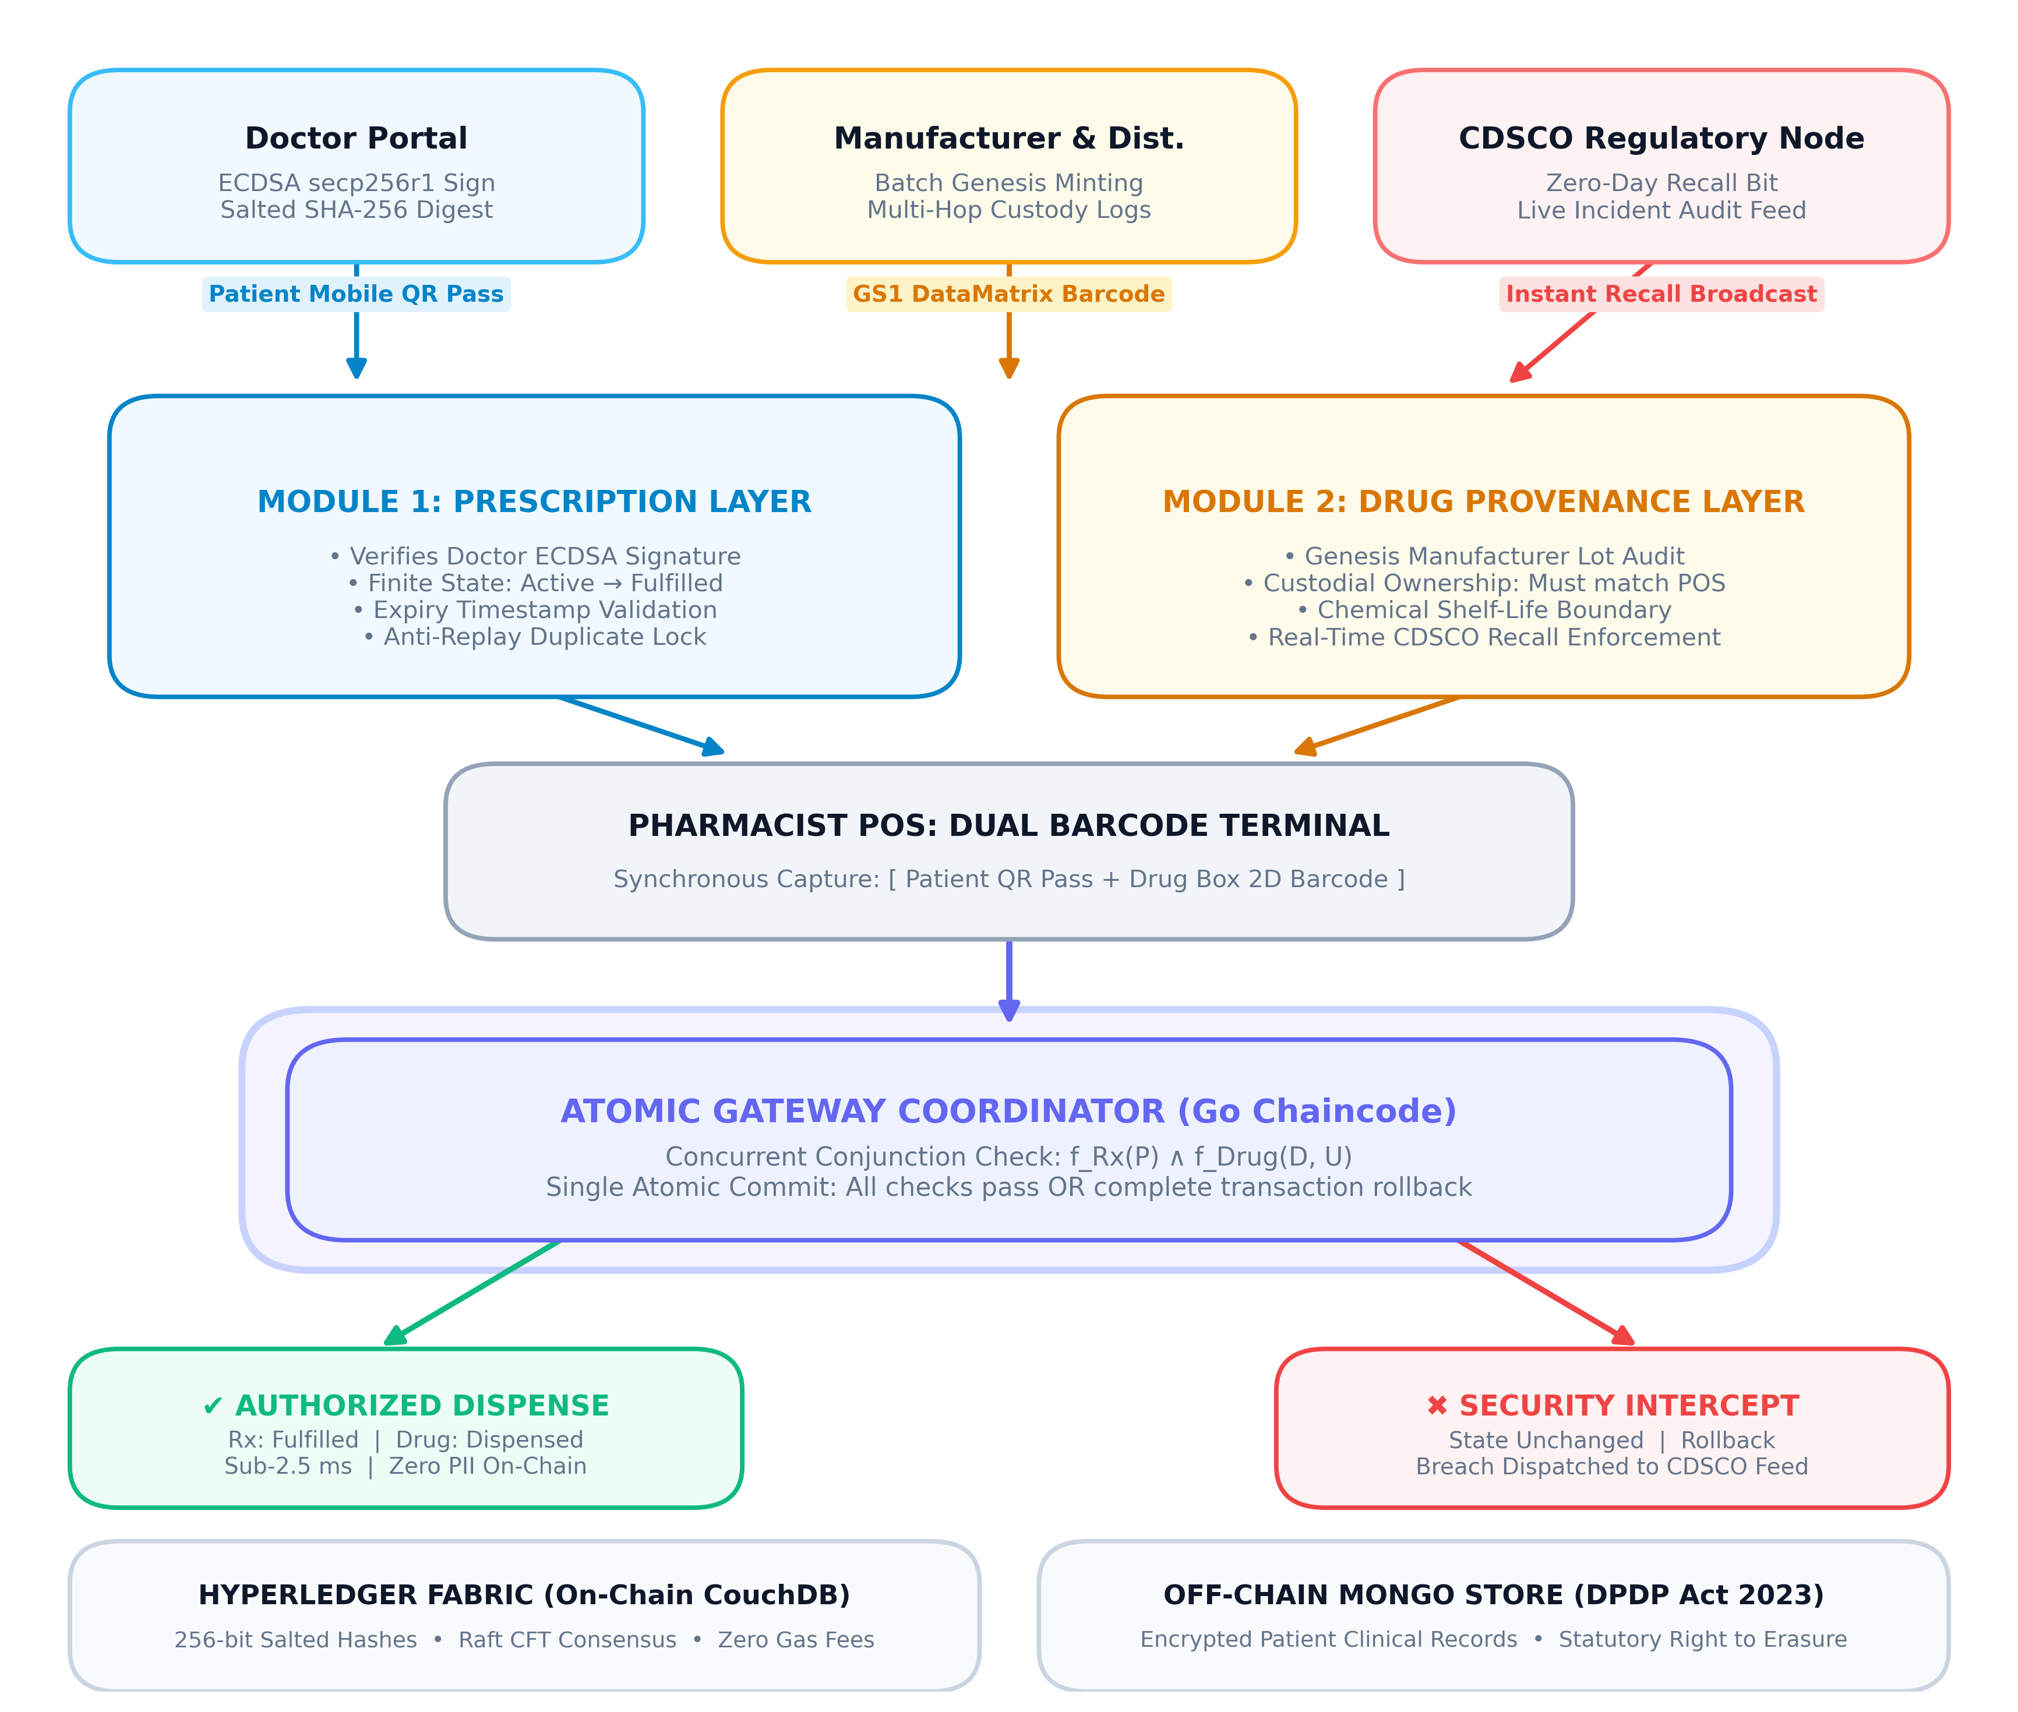
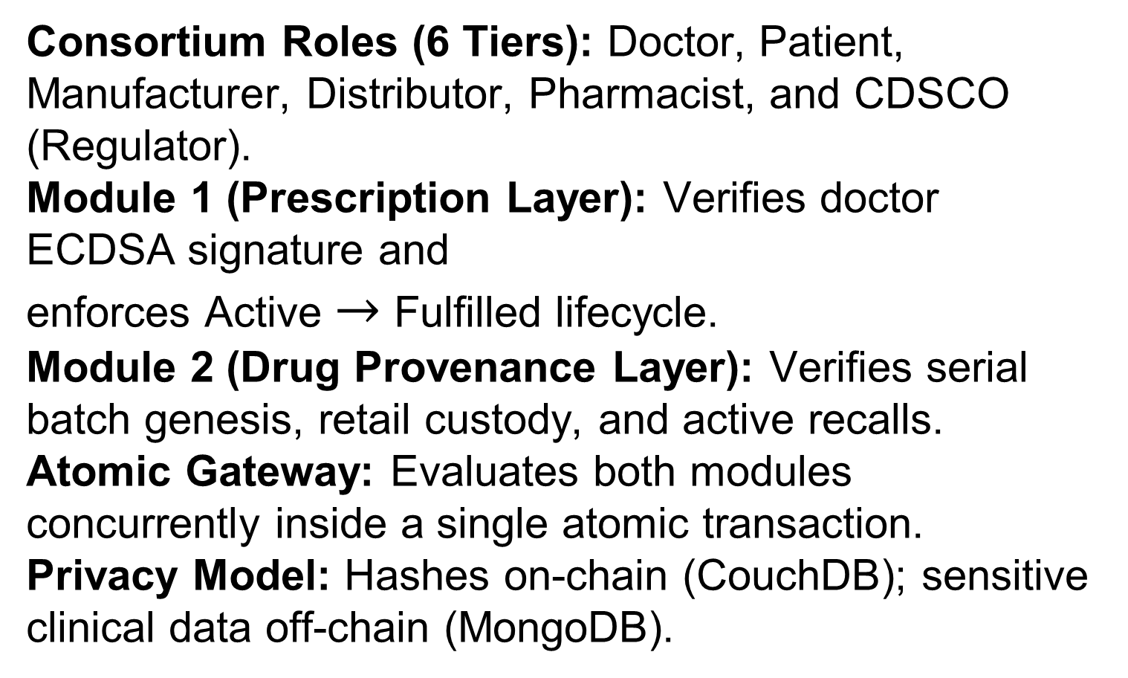
System Architecture
Consortium Roles (6 Tiers): Doctor, Patient, Manufacturer, Distributor, Pharmacist, and CDSCO (Regulator).
Module 1 (Prescription Layer): Verifies doctor ECDSA signature and enforces Active $→$ Fulfilled lifecycle.
Module 2 (Drug Provenance Layer): Verifies serial batch genesis, retail custody, and active recalls.
Atomic Gateway: Evaluates both modules concurrently inside a single atomic transaction.
Privacy Model: Hashes on-chain (CouchDB); sensitive clinical data off-chain (MongoDB).

Slide 5
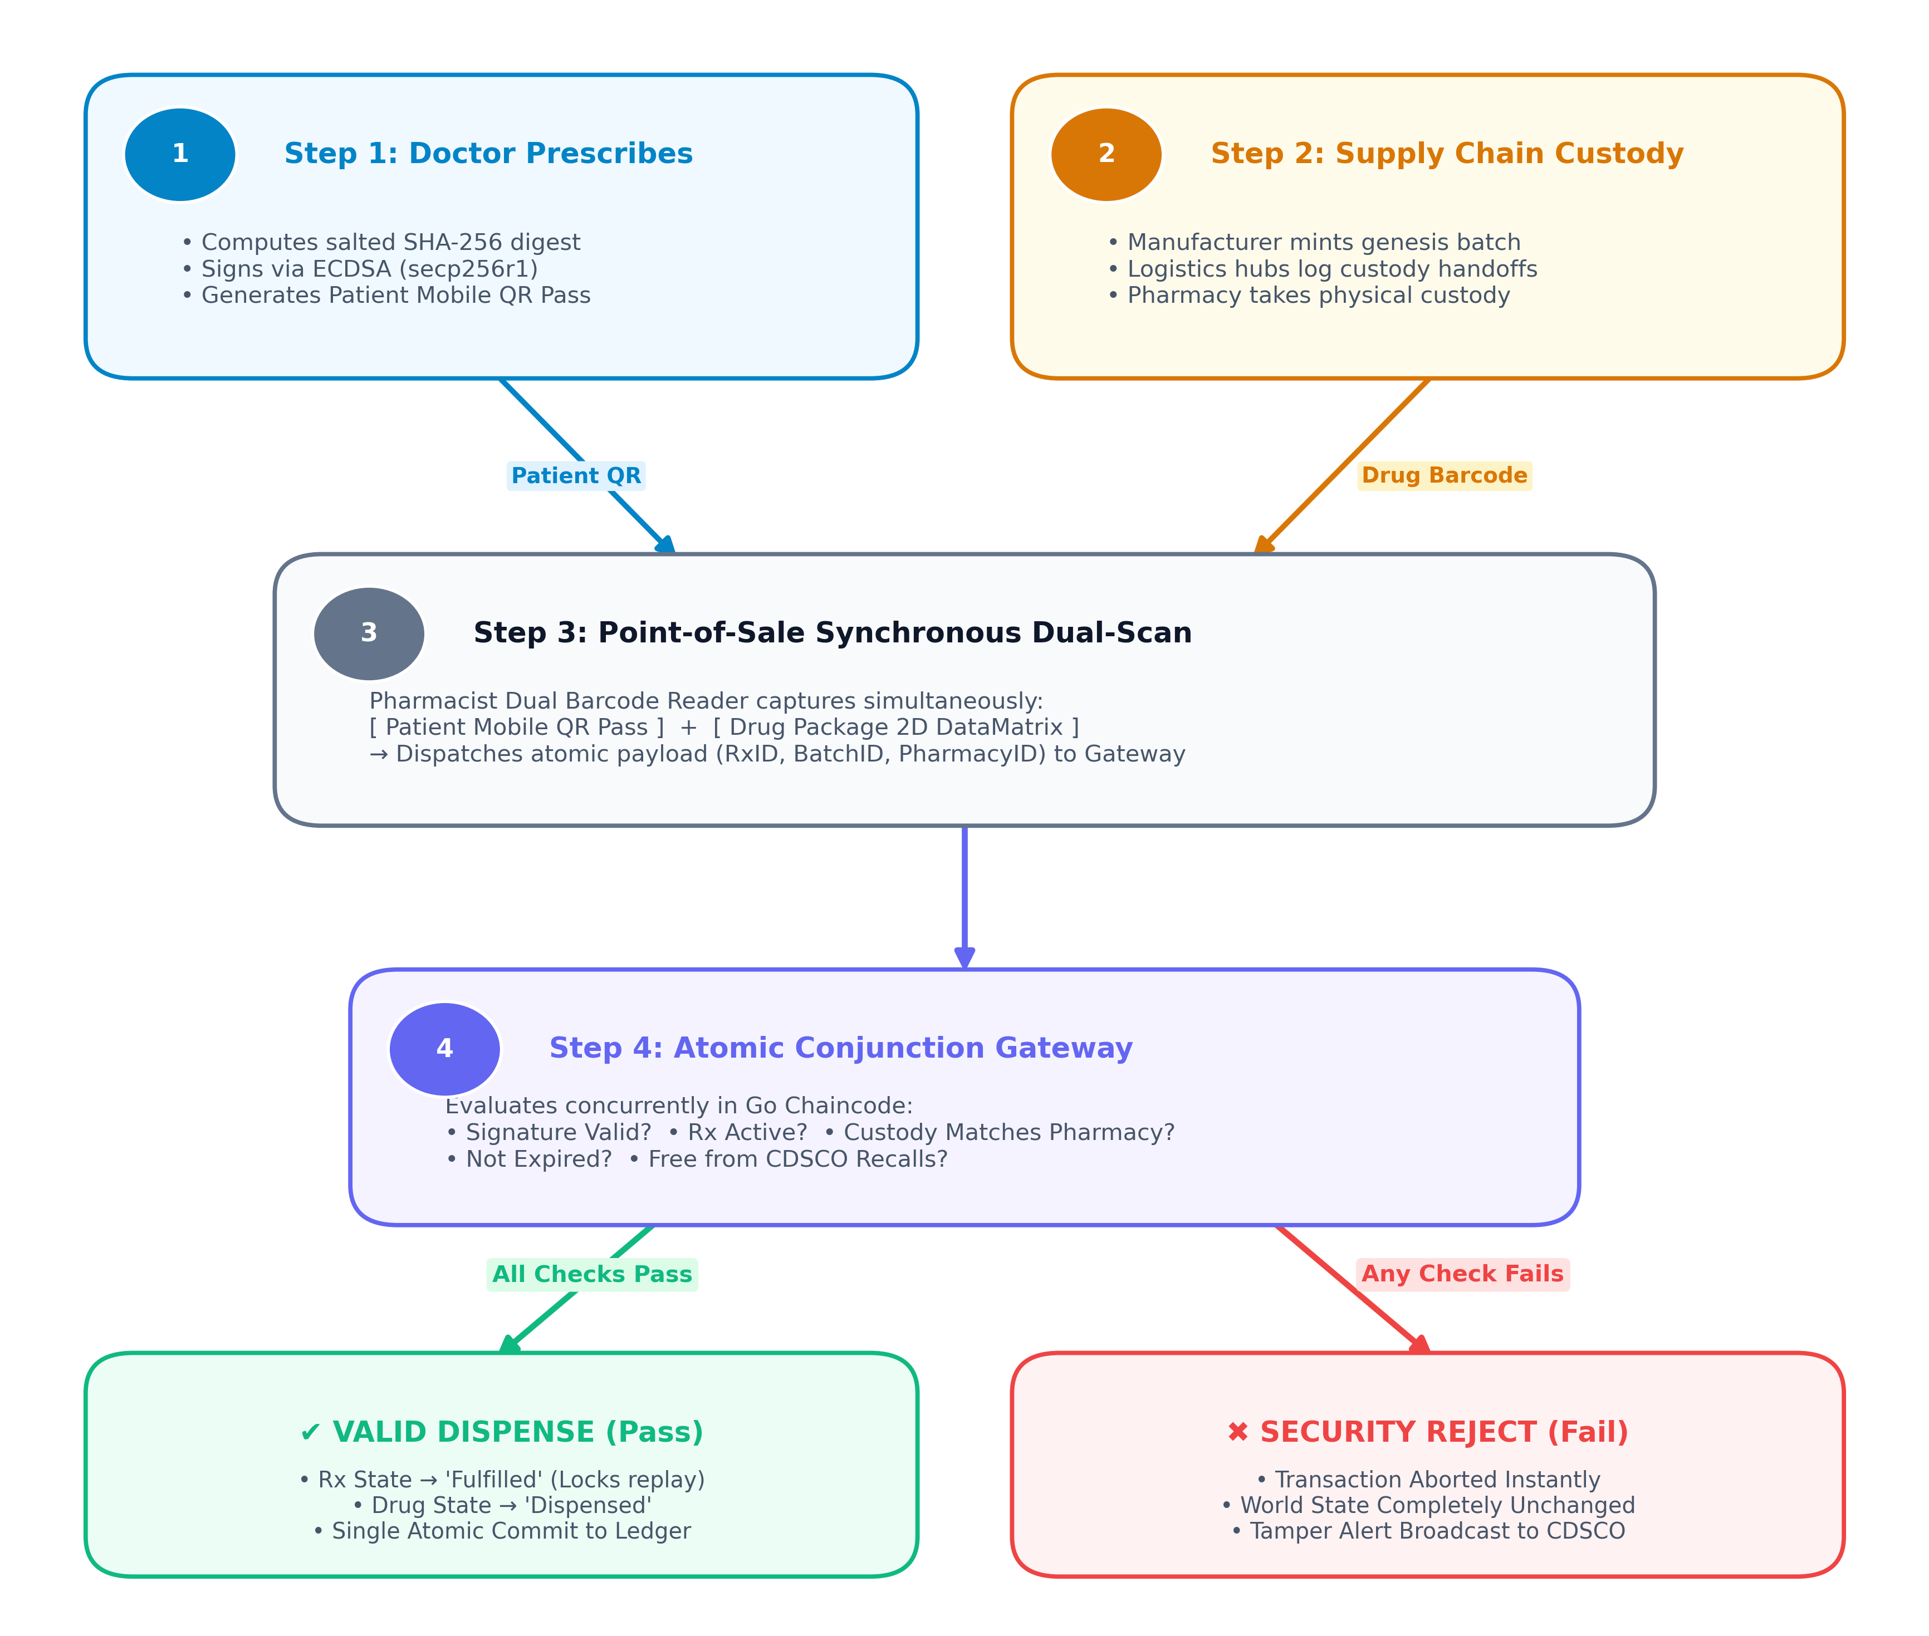
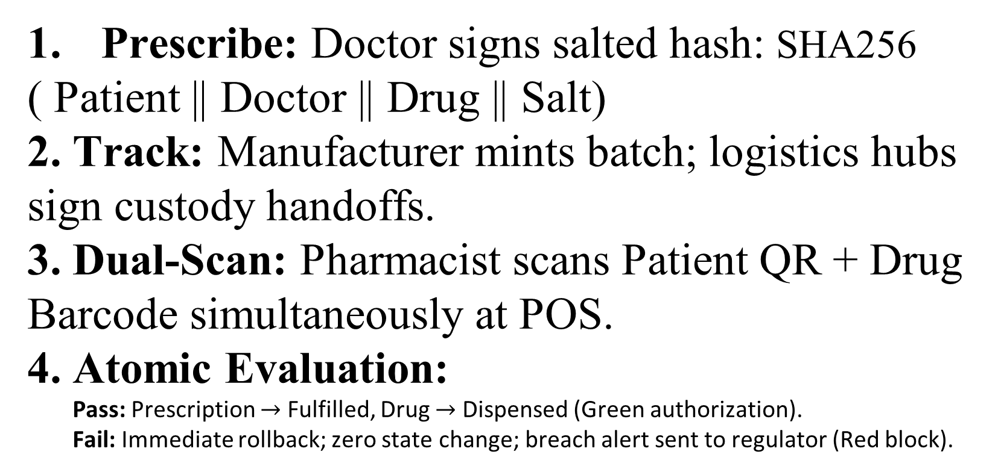
How Does the Model Work? (Verification Flow)
Prescribe: Doctor signs salted hash: $\text{SHA256}$
( Patient || Doctor || Drug || Salt)
2. Track: Manufacturer mints batch; logistics hubs sign custody handoffs.
3. Dual-Scan: Pharmacist scans Patient QR + Drug Barcode simultaneously at POS.
4. Atomic Evaluation:
  Pass: Prescription $→$ Fulfilled, Drug $→$ Dispensed (Green authorization).
  Fail: Immediate rollback; zero state change; breach alert sent to regulator (Red block).

Slide 6
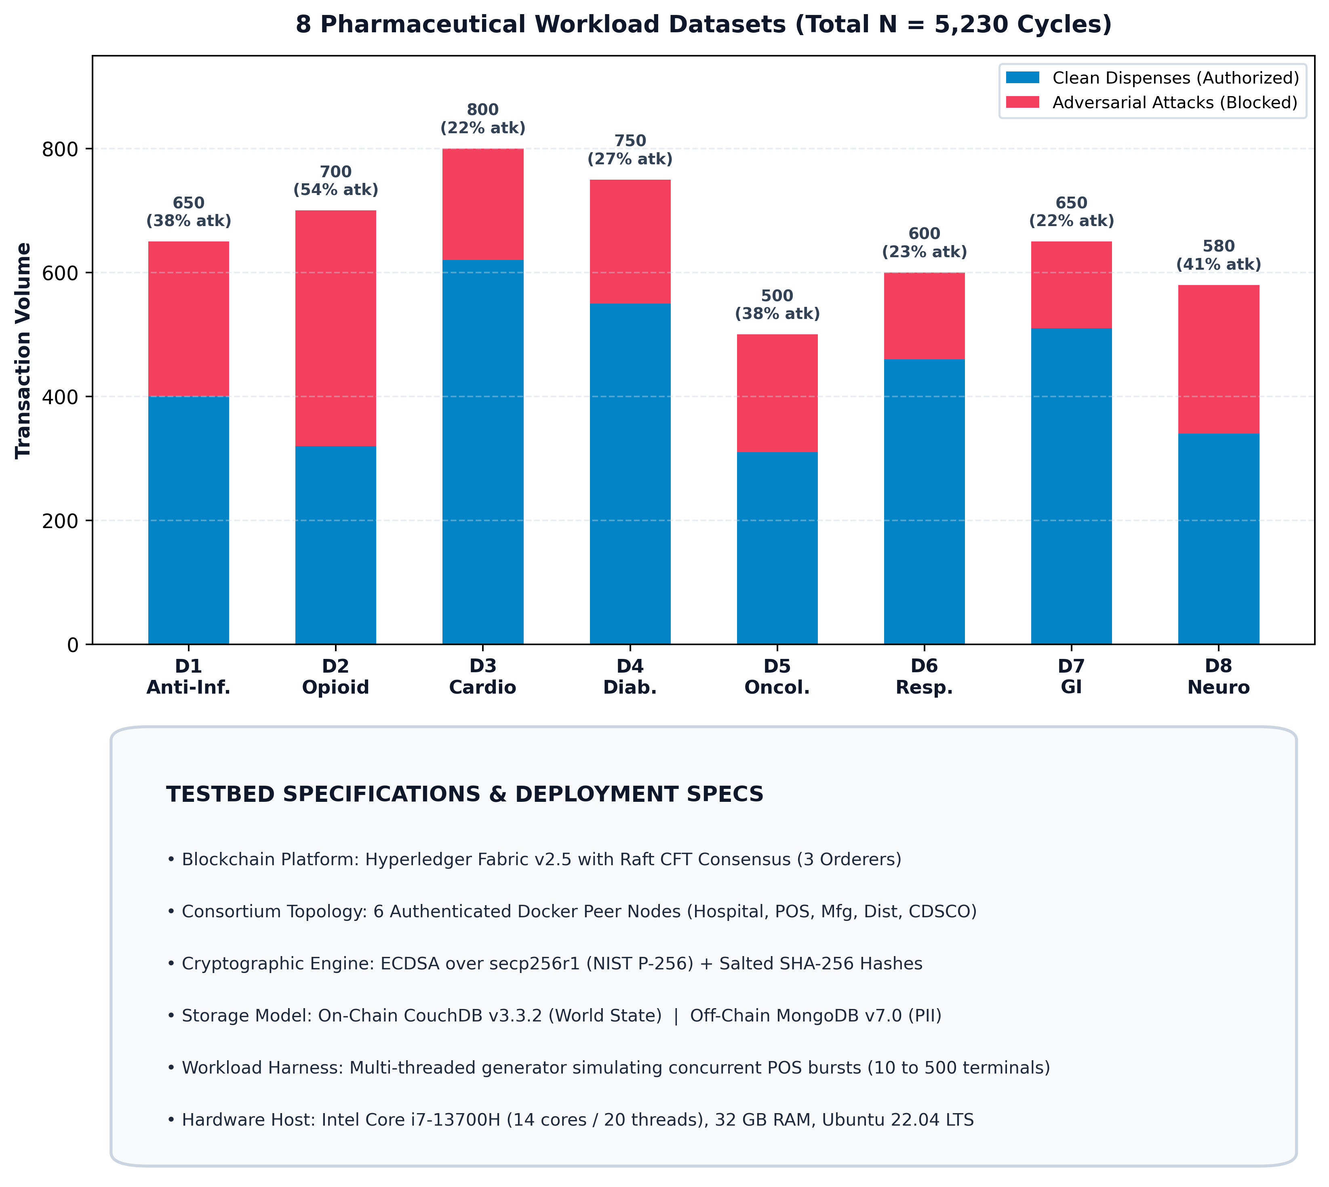
Datasets & Experimental Setup
8 Therapeutic Workloads: Synthesized 5,230 dispensing cycles across Anti-Infectives, Opioids, Cardiovascular, Antidiabetics, Oncology, Respiratory, GI, and Neuro-Psychiatric drugs.
Realistic Adversarial Threat Ratios: Attack attempts range from 21.5% to 54.3% per category (1,720 total adversarial cycles).
6 Simulated Threat Vectors:
  Clean legitimate dispenses (3,510 authorized)
  Replay & double-spend fraud (460 attacks)
  Counterfeit / bogus drug lot barcodes (380 attacks)
  Broken supply-chain physical custody (430 attacks)
  CDSCO regulatory drug recalls (240 attacks)
  Expired prescription orders (210 attacks)
High-Throughput Concurrency Testing: Workload generator simulates 10 to 500 simultaneous pharmacy terminals.

Slide 7
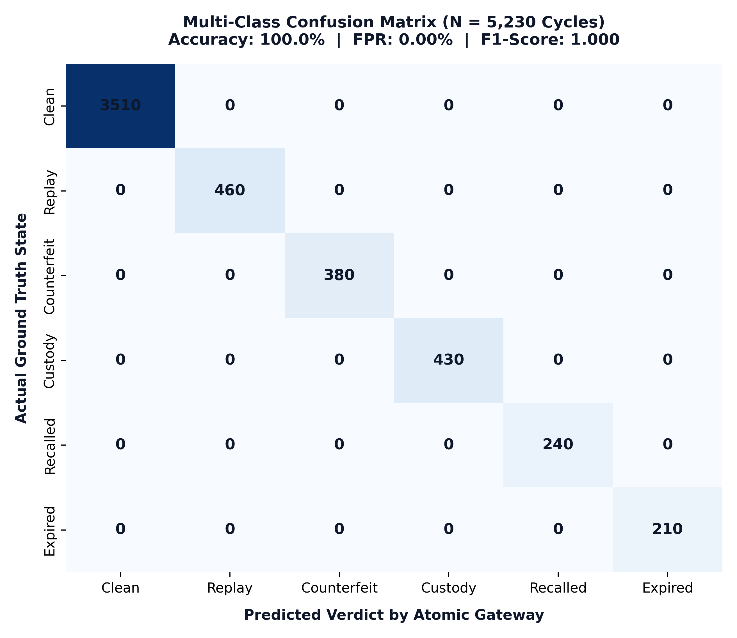
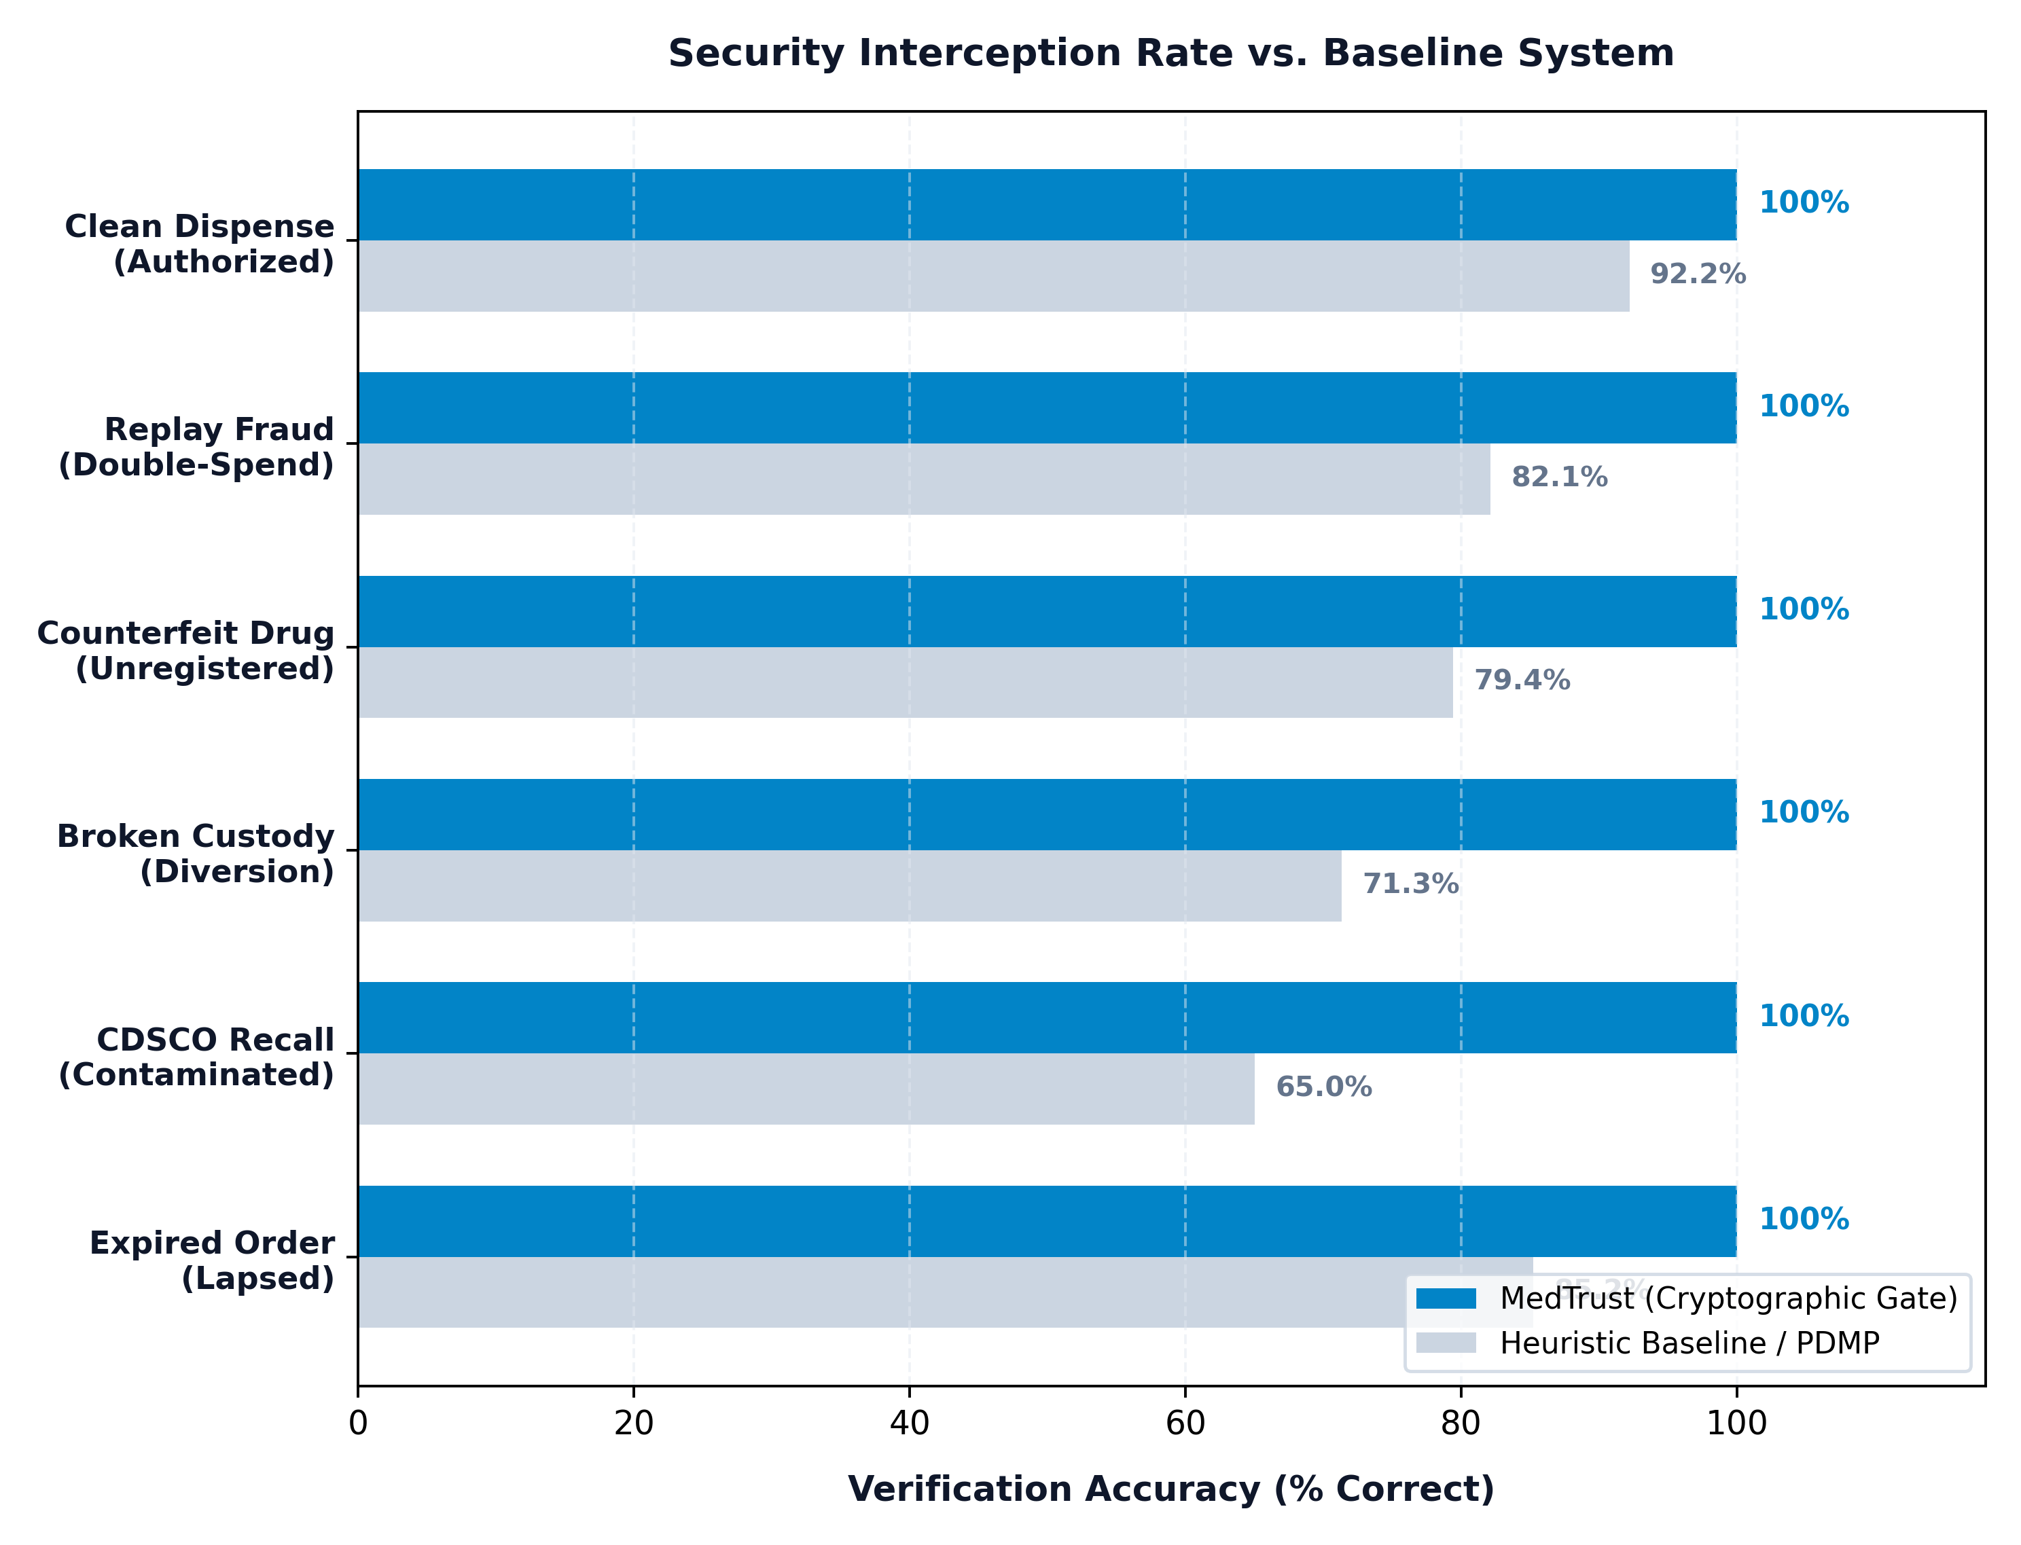
Overall Results & Comparison

Slide 8
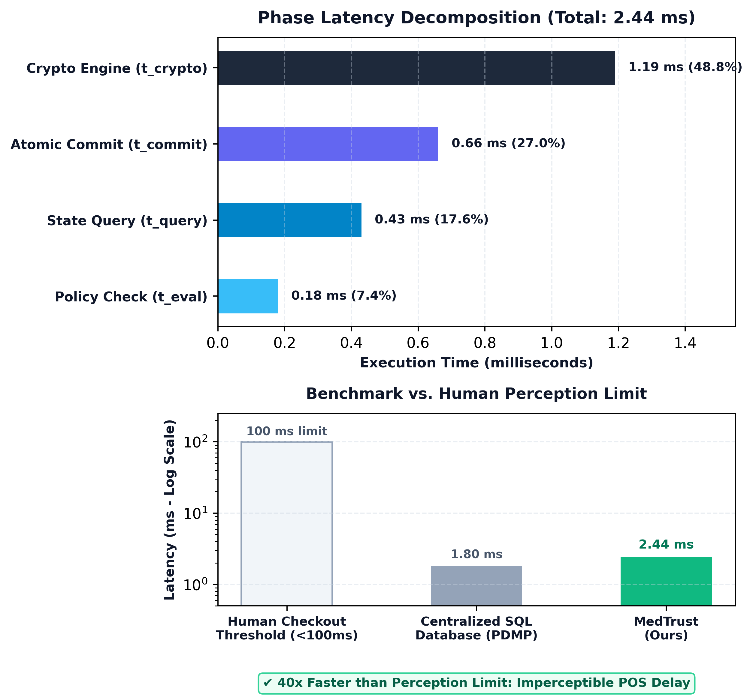
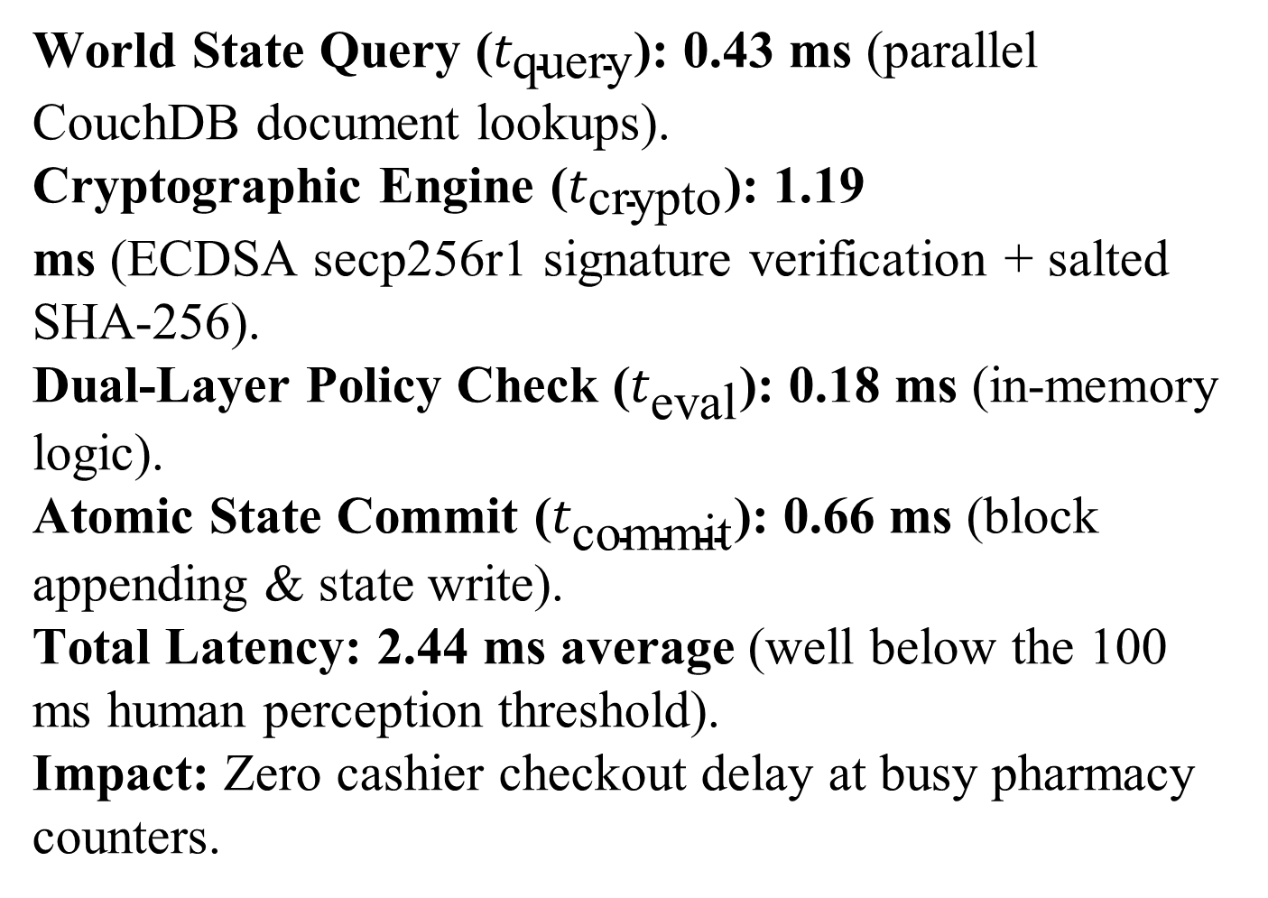
Latency Breakdown & Micro-Benchmarks
World State Query ($t_{\text{query}}$): 0.43 ms (parallel CouchDB document lookups).
Cryptographic Engine ($t_{\text{crypto}}$): 1.19 ms (ECDSA $\text{secp256r1}$ signature verification + salted SHA-256).
Dual-Layer Policy Check ($t_{\text{eval}}$): 0.18 ms (in-memory logic).
Atomic State Commit ($t_{\text{commit}}$): 0.66 ms (block appending & state write).
Total Latency: 2.44 ms average (well below the 100 ms human perception threshold).
Impact: Zero cashier checkout delay at busy pharmacy counters.

Slide 9
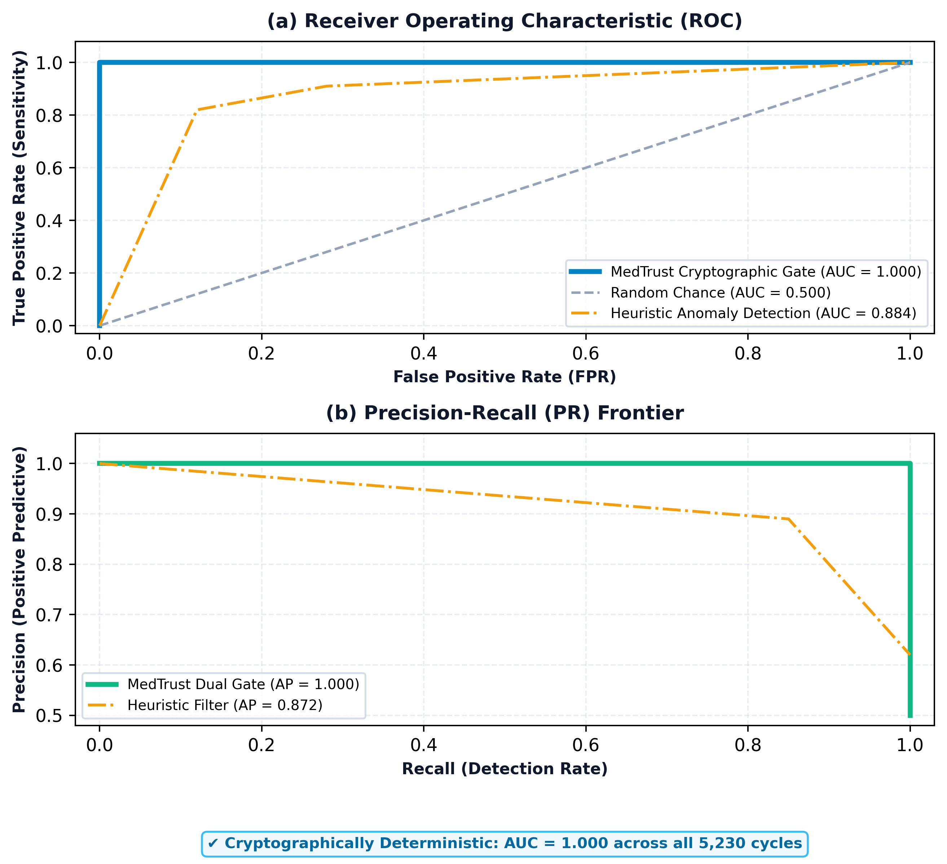
Security Boundary & Attack Resilience
Evaluation Scope (1,720 Adversarial Attacks):
Tested across 5,230 simulated cycles covering 6 real-world dispensing threat vectors.
Deterministic Threat Interception (100% Block Rate):
  Replay & Double-Spend (460/460 blocked): State machine locks filled prescriptions, stopping doctor-shopping.
  Counterfeit Batches (380/380 blocked): Unregistered box barcodes fail genesis authentication.
  Broken Custody Chain (430/430 blocked): Stolen or diverted stock rejected at counter.
  CDSCO Recalls (240/240 blocked): Flagged contaminated lots blocked nationwide in real time.
  Expired Orders (210/210 blocked): Outdated clinical treatment windows halted.
Graph (a) & (b) — Boundary Performance:
  Ideal Frontiers: Achieves AUC = 1.000 (ROC) and AP = 1.000 (Precision-Recall), outperforming heuristic filters (AUC = 0.884).
  Zero False Positives (0.00% FPR): Valid patients presenting genuine prescriptions are never falsely rejected.
  Instant Alerting: Every blocked attack dispatches an automated incident report to the CDSCO monitor.

Slide 10
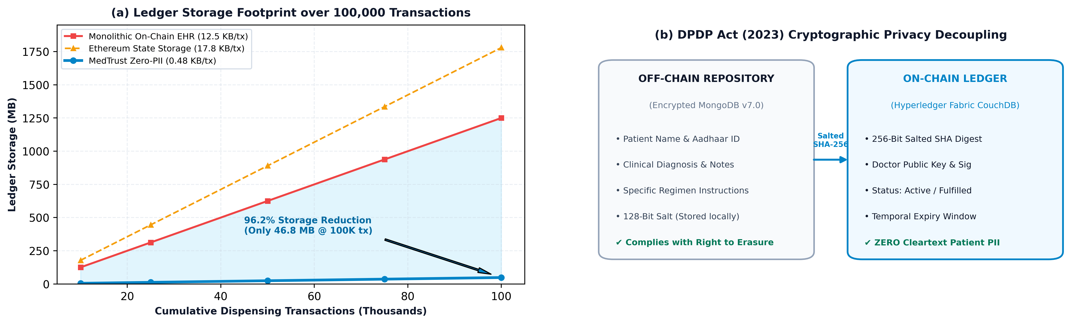
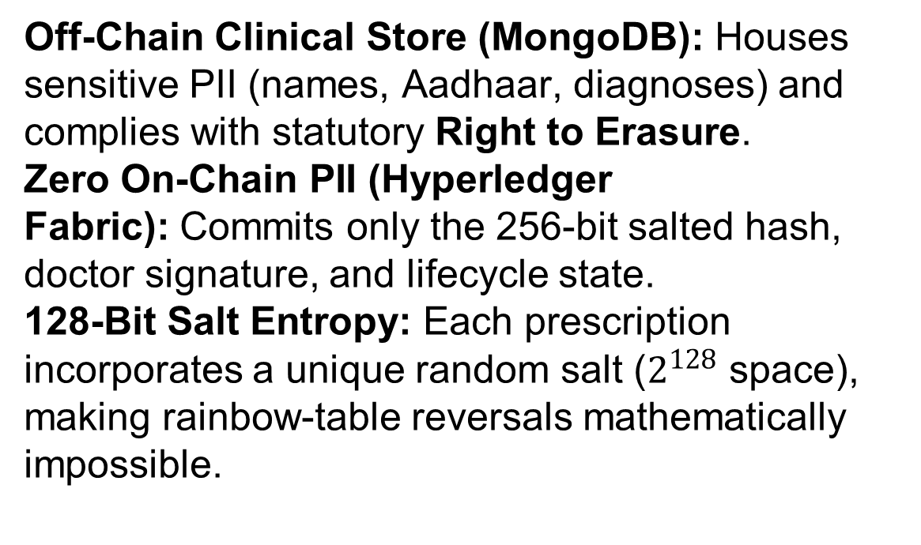
Privacy Preservation & DPDP Act (2023)
Off-Chain Clinical Store (MongoDB): Houses sensitive PII (names, Aadhaar, diagnoses) and complies with statutory Right to Erasure.
Zero On-Chain PII (Hyperledger Fabric): Commits only the 256-bit salted hash, doctor signature, and lifecycle state.
128-Bit Salt Entropy: Each prescription incorporates a unique random salt ($2^{128}$ space), making rainbow-table reversals mathematically impossible.
  Compact On-Chain Footprint: Requires only 0.48 KB per transaction vs. 12.5 KB for monolithic EHR blockchains.
  100K Transaction Scaling: Consumes just 46.8 MB (vs. 1,250 MB in standard EHR and 1,780 MB in Ethereum).
  Edge Deployment: Prevents ledger bloat, allowing low-cost pharmacy terminals to run full verification nodes.

Slide 11
Multi-Dimensional Comparative Analysis
Vs. Public Ethereum E-Prescription:
Ethereum incurs $2–$24 transaction gas fees, 15-second block delays, and a 15 TPS throughput bottleneck. MedTrust is gas-free, executes in 2.44 ms, and scales to 1,690 TPS.
Vs. PharmaChain / HyperChain (Drug Provenance):
Supply-chain platforms track serialized cartons but completely ignore prescription validity—leaving a massive backdoor for forged or replayed prescriptions.
Vs. Centralized State PDMPs (Traditional SQL):
Centralized databases present single-point-of-failure risks, insider tampering vulnerabilities, and store unencrypted patient PII on centralized servers.
The MedTrust Advantage (Unified Conjunction):
The only framework providing synchronous dual-layer verification, sub-3ms cashier latency, zero transaction costs, and full DPDP Act 2023 privacy compliance.

Slide 12
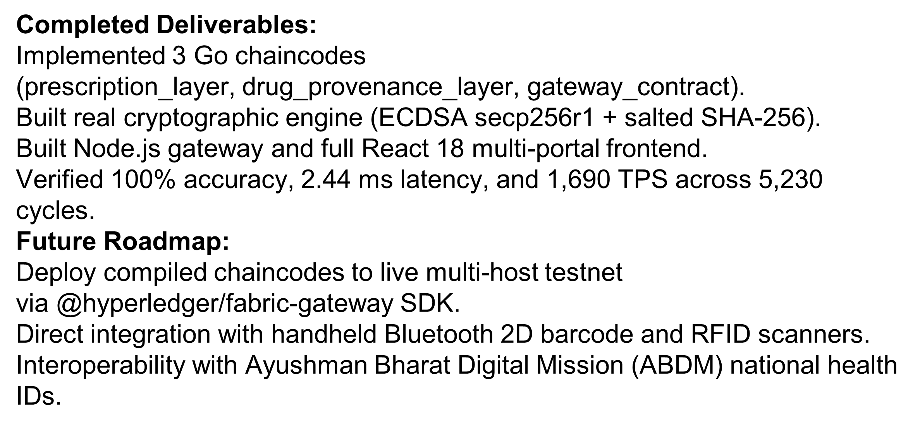
Conclusion & Future Work
Completed Deliverables:
  Implemented 3 Go chaincodes (prescription_layer, drug_provenance_layer, gateway_contract).
  Built real cryptographic engine (ECDSA $\text{secp256r1}$ + salted SHA-256).
  Built Node.js gateway and full React 18 multi-portal frontend.
  Verified 100% accuracy, 2.44 ms latency, and 1,690 TPS across 5,230 cycles.
Future Roadmap:
  Deploy compiled chaincodes to live multi-host testnet via @hyperledger/fabric-gateway SDK.
  Direct integration with handheld Bluetooth 2D barcode and RFID scanners.
  Interoperability with Ayushman Bharat Digital Mission (ABDM) national health IDs.

Slide 13
References
[1] S. Pancari et al., "Ethereum vs. Hyperledger Fabric Comparison," Sensors, 2023.
[2] A. Musamih et al., "Blockchain Drug Traceability," IEEE Access, 2021.
[3] CEUR Workshop Proceedings, "E-Prescription Traceability," Vol. 3616, 2024.
[4] N. Zakari et al., "Blockchain in Pharmaceutical Industry," PeerJ Computer Science, 2022.
[5] Ministry of Law and Justice, "Digital Personal Data Protection Act, 2023," Govt. of India.

